Slide 1

Measurement of extensive and intensive smallholder inclusion in high value markets.

Slide 3
High value markets are rural development tools
Smallholder orientated high value markets remain the preeminent market-based policy that seeks to achieve welfare and development gains for rural smallholder farming households.
Smallholder high value markets represent the modern value chains that link smallholder farmers in developing countries to lucrative markets.
72% of IFAD’s projects in 2020 had components that link smallholders to high value markets (IFAD 2020).

Slide 4
High value markets are rural development tools
A range of literature highlights, on average, individuals and smallholder households that participate in high value markets typically receive higher incomes
Bellemare and Bloem (2018)
Ton et al. (2018)
German et al. (2020)
Participation often refers to selling produce to high value markets - but can also extend to other measures such as decision making, voice, and employment in processing or downstream activities.

Slide 5
High value markets are not always inclusive
Despite the benefits, there are significant differences between who participates in high value markets, and who does not.
This evidence largely derives from:
Observing differences in summary statistics between participants and non-participants. | Interpretation of first stage regression models in value chain impact evaluations (which seek to control for self-selection. Summarised by Ola and Menapace (2020). | A smaller selection of studies seeking to understand the determinants of participation Examples include Anderson et al (2015) and Ba et al (2019). | Qualitative studies exploring elite capture and determinants Vicol (2018) and Xu et al (2019) are good examples.

Slide 6
High value markets are not always inclusive
Why are high value markets not inclusive?
Buyer side transaction costs.
Smallholder side transaction/ investment costs.
Social factors (Elite capture and discrimination).
Smallholder preferences.
Buyers in high value markets may restrict eligibility for smallholders to participate to minimise exposure to fixed transaction costs (e.g. training, monitoring, quality assurance)
For example, high upfront costs for credit constrained households, paperwork for households with lower education.
Socially connected individuals capturing benefits of high value markets.
Other cohorts such as women unable to participate to the same degree.
Participating in high value markets is only one livelihood pathway.
Some cohorts may opt to participate in other markets, despite the value chain being available to them.

Slide 7
Objectives of this study
A failure to achieve inclusion outcomes for high value markets means the potential benefits are failing to reach individuals or households that need these benefits the most.
Objectives
Develop inclusion measurement methodologies for smallholder orientated high value markets.
1.
Test these inclusion measurement methodologies using a case study of coffee farmers who participate in commodity and high value markets in Eastern Uganda
2.

Slide 8
Defining the objectives for inclusion measurement

Slide 9
Example 1:
Inclusive or exclusive?
A buyer in high value markets sets minimum plot sizes for contract participation due to high plot level transaction costs (such as monitoring of production processes).
Exclusive - those with lower land holdings are unable to participate

Slide 10
Example 2
Inclusive or exclusive?
A buyer enters a new region and selects a small number of smallholder farmers ‘at random’ to participate. All these smallholders participate.
Inclusive - in a statistical sense as every smallholder has equal likelihood to participate.
High value markets not ‘at scale’ as only a small number of smallholders participate.

Slide 11
Example 3
Inclusive or exclusive?
A monopsonist buyer engages with all smallholder farmers in an area.
These farmers engage with the value chain, even when it is a bad deal for them, because of few outside options.
Inclusive - as every smallholder has equal likelihood to participate.
But likely delivers low to negative value for participating smallholders (the role of standard impact evaluations).

Slide 12
Example 4
Inclusive or exclusive?
A value chain enters a new area and offers participation to all farmers.
Upfront participation costs are high, but price premiums compensate for this the smallholders can afford these upfront costs.
Exclusive – even when presented the opportunity to participate, smallholders with lower assets or credit constraints cannot afford the upfront participation costs, and opt out of participation.

Slide 13
Example 5
Inclusive or exclusive?
Inclusive – the buyer makes itself available to all famers, and those who wish to engage in the value chain can do so, due to low entry costs.
However, differences in preferences lead to different cohorts participating with this high value buyer. This suggests the buyer may be ‘inclusive’, but low value for certain cohorts.
A buyer enters a new area and offers participation to all farmers. Participation costs are negligible and price premiums are available.
Some women choose to opt out in favour of women’s only cooperatives as these cooperatives provide inputs and social capital which these women prefer.

Slide 14
Example 6
Inclusive or exclusive?
Inclusive at the extensive margin, exclusive at the intensive margin.
We may also want to consider the heterogeneity of benefits derived from this participation (outside the scope of inclusion measurement).
A cooperative buys produce to any smallholder that presents itself to the buying location, and the distribution of smallholders that do so is inclusive.
However, only a select few elite individuals are allowed to participate in cooperative decision making and voting rights – with women in particular excluded from these processes.

Slide 15
Example 7
Inclusive or exclusive?
Exclusive – for men. Exclusive at a value chain level, but likely contributes to more inclusive high value market access more generally.
A Women’s only cooperative establishes to provide women with more opportunities for cooperative participation (e.g. decision making, voice etc).

Slide 16
Objectives of inclusion measurement
Flexible for different measures of extensive and intensive participation.
Be applicable to measure inclusion at various scales (e.g. individual buyers and value chains, up to broader market access)
Be able to rank inclusion outcomes across different value chains, markets, or across time (recognising general limitations of external validity in any empirical work).
Be able to identify the likelihood of participation in high value markets conditional on structural factors/circumstances outside of a smallholder’s control.
We want to know whether differences in participation outcomes are driven entirely of these circumstances (exclusive), or entirely due to preferences for different value outcomes (inclusive, but low value).
This keeps measurement of inclusion distinct from well-established frameworks for assessing value chain benefits.

Slide 17
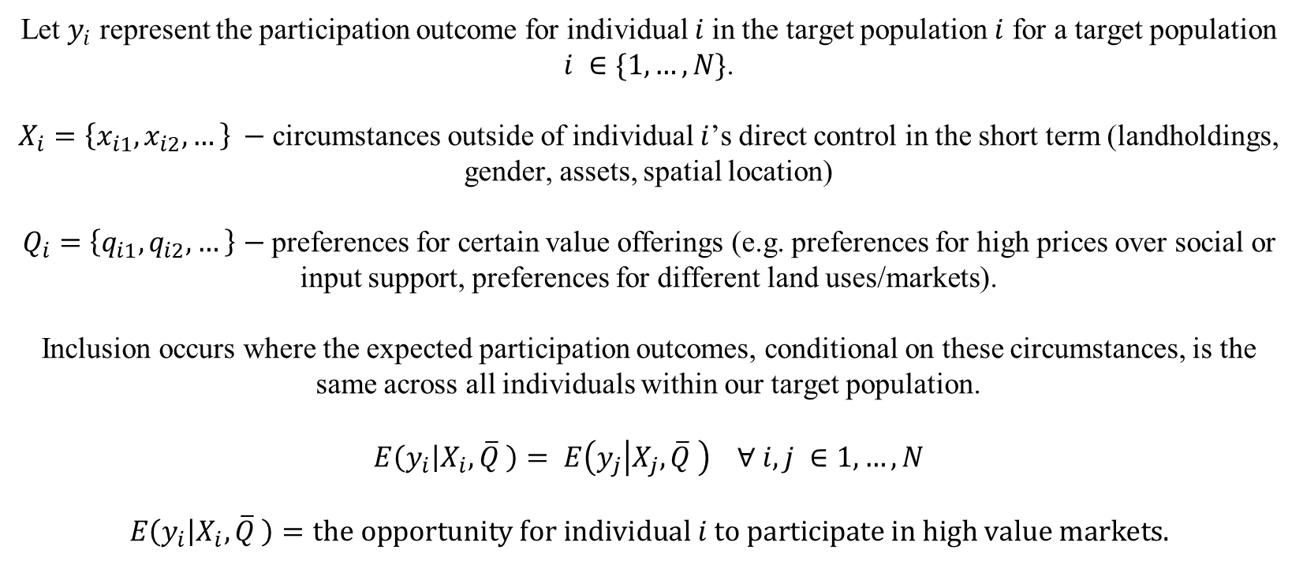
Objectives of inclusion measurement
Let $y_{i}$ represent the participation outcome for individual $i$in the target population $i$ for a target population $i ∈\{1,…,N\}$.
$X_{i}=\left\{x_{i1}, x_{i2},…\right\} −$circumstances outside of individual $i$’s direct control in the short term (landholdings, gender, assets, spatial location)
$Q_{i}=\left\{q_{i1}, q_{i2},…\right\}$ $−$preferences for certain value offerings (e.g. preferences for high prices over social or input support, preferences for different land uses/markets).
Inclusion occurs where the expected participation outcomes, conditional on these circumstances, is the same across all individuals within our target population.
$$E\left(y_{i} | X_{i},\overline{Q} \right)= E\left(y_{j} | X_{j},\overline{Q} \right) ∀ i,j ∈1,…,N$$
$$E\left(y_{i} | X_{i},\overline{Q} \right)=the opportunity for individual i to participate in high value markets.$$

Slide 18
Equalising opportunities has roots in a large equality in opportunity literature
Sen (1979),
Arneson (1989),
Roemer (1998),
Ramos and Van Der Gaer (2016).
Inequality of opportunity arises when the structural factors (circumstances or capabilities), rather than individual efforts and preferences, determine a person's chances of economic success or wealth.
Equality occurs when distributions in outcomes are entirely determined by the personal choices and efforts of individuals.
Inequality driven by individual efforts and preferences may be desirable from a rural development perspective as it indicates a variety of livelihood pathways and competitive markets in which smallholders can opt in and out of participation

Slide 19

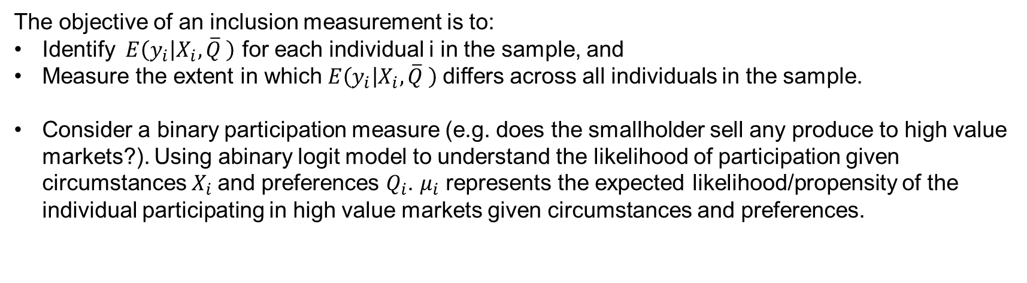
Empirical measurement of inclusion
The objective of an inclusion measurement is to:
Identify $E\left(y_{i} | X_{i},\overline{Q} \right)$ for each individual i in the sample, and
Measure the extent in which $E\left(y_{i} | X_{i},\overline{Q} \right)$differs across all individuals in the sample.
Consider a binary participation measure (e.g. does the smallholder sell any produce to high value markets?). Using abinary logit model to understand the likelihood of participation given circumstances $X_{i}$and preferences $Q_{i}$. $μ_{i}$ represents the expected likelihood/propensity of the individual participating in high value markets given circumstances and preferences.
$y_{i}\sim bernoulli\left(μ_{i}\right)$.
$μ_{i}=g^{−1}(η_{i})$
$η_{i}=X_{i}′β+ Q_{i}′γ$
$$E\left(y_{i} | X_{i}, Q_{i}\right)= μ_{i}$$

Slide 20
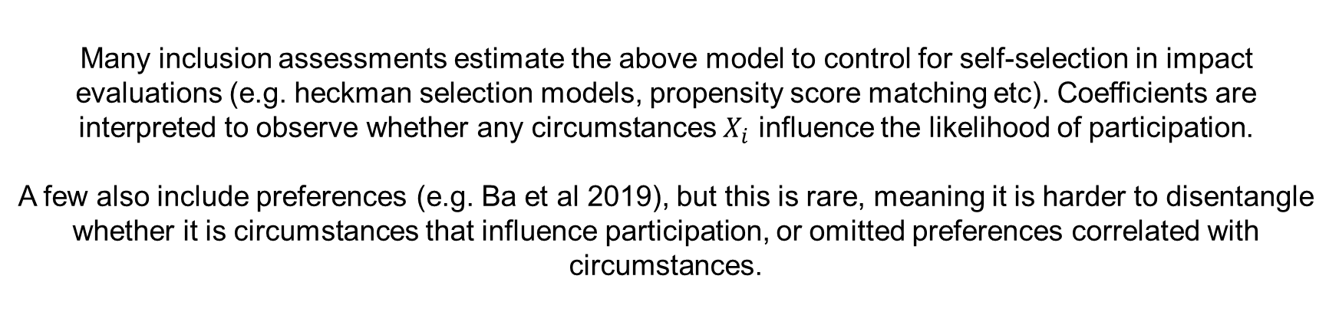
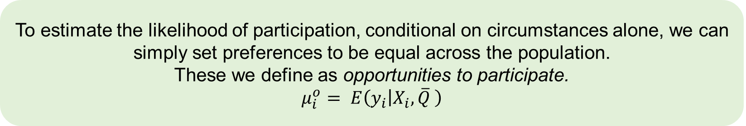
Empirical measurement of inclusion
$$E\left(y_{i} | X_{i}, Q_{i}\right)= μ_{i}$$
Many inclusion assessments estimate the above model to control for self-selection in impact evaluations (e.g. heckman selection models, propensity score matching etc). Coefficients are interpreted to observe whether any circumstances $X_{i}$ influence the likelihood of participation.
A few also include preferences (e.g. Ba et al 2019), but this is rare, meaning it is harder to disentangle whether it is circumstances that influence participation, or omitted preferences correlated with circumstances.
To estimate the likelihood of participation, conditional on circumstances alone, we can simply set preferences to be equal across the population.
These we define as opportunities to participate.
$$μ_{i}^{o}= E\left(y_{i} | X_{i},\overline{Q} \right)$$

Slide 21
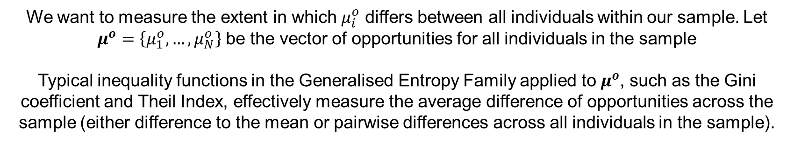
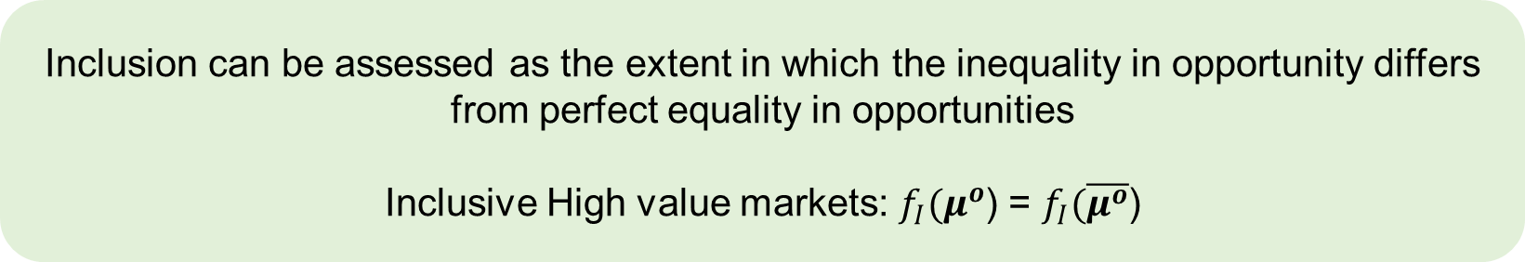
Empirical measurement of inclusion
$$μ_{i}^{o}= E\left(y_{i} | X_{i},\overline{Q} \right)$$
We want to measure the extent in which $μ_{i}^{o}$ differs between all individuals within our sample. Let $μ^{o}=\left\{μ_{1}^{o}, …, μ_{N}^{o}\right\}$ be the vector of opportunities for all individuals in the sample
Typical inequality functions in the Generalised Entropy Family applied to $μ^{o}$, such as the Gini coefficient and Theil Index, effectively measure the average difference of opportunities across the sample (either difference to the mean or pairwise differences across all individuals in the sample).
Inclusion can be assessed as the extent in which the inequality in opportunity differs from perfect equality in opportunities
Inclusive High value markets: $f_{I}(μ^{o}$) = $f_{I}(\overline{μ^{o}}$)

Slide 22
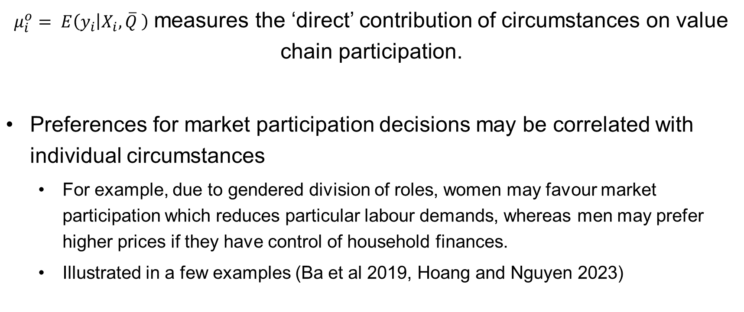
Direct and reduced form measurement of inclusion
$μ_{i}^{o}= E\left(y_{i} | X_{i},\overline{Q} \right)$ measures the ‘direct’ contribution of circumstances on value chain participation. Preferences for market participation decisions may be correlated with individual circumstances For example, due to gendered division of roles, women may favour market participation which reduces particular labour demands, whereas men may prefer higher prices if they have control of household finances. Illustrated in a few examples (Ba et al 2019, Hoang and Nguyen 2023)

Slide 23
Direct and reduced form measurement of inclusion
Two alternative views to incorporate preferences that are determined (or at least associated with circumstances (Ramos and Van der Gaer (2016):
Individuals should only be accountable for outcomes within their control, meaning preferences dictated entirely by the circumstances of the individual (i.e. gendered household roles) should be incorporated within the ‘circumstance set’.
For example, from Arnseon (1989) and Roemer (1998)
Individuals should be accountable for all factors (preferences) within their control, even when these preferences are determined by initial circumstances
Deriving, amongst others, from Rawls (1971)

Slide 24
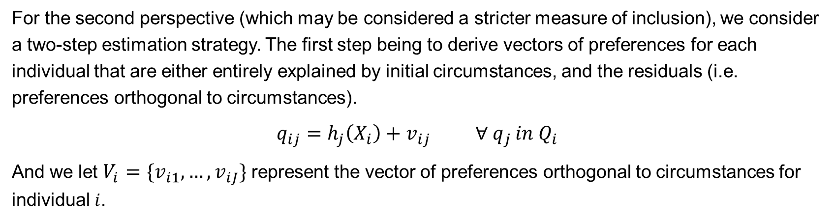
Direct and reduced form measurement of inclusion
The direct model already presented largely captures the first perspective.
For the second perspective (which may be considered a stricter measure of inclusion), we consider a two-step estimation strategy. The first step being to derive vectors of preferences for each individual that are either entirely explained by initial circumstances, and the residuals (i.e. preferences orthogonal to circumstances).
$$q_{ij}=h_{j}\left(X_{i}\right)+v_{ij} ∀ q_{j }in Q_{i}$$
And we let $V_{i}=\{v_{i1},…, v_{iJ}\}$ represent the vector of preferences orthogonal to circumstances for individual$i$.

Slide 25
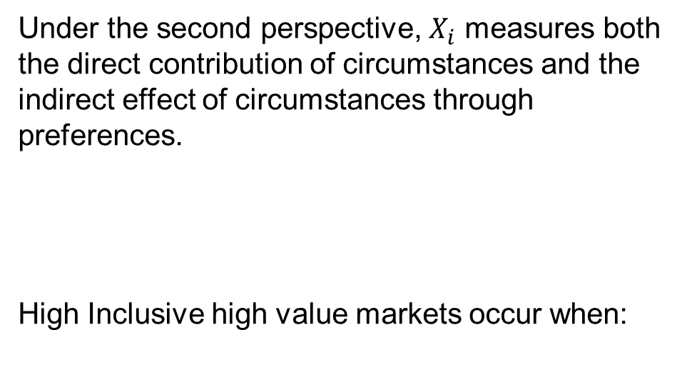
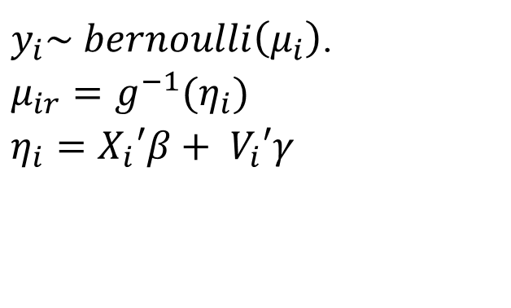
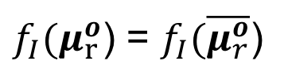
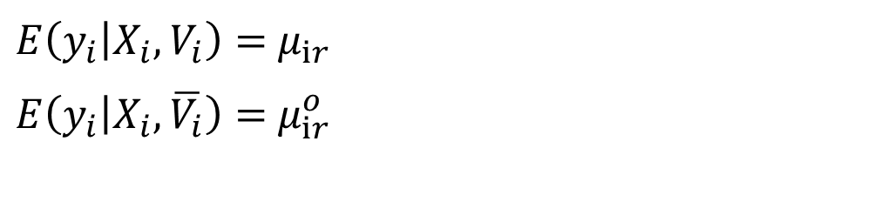
Direct and reduced form measurement of inclusion
Step 2 simply estimates the opportunities for participation as done for the direct model (using a logit model as an example):
Under the second perspective, $X_{i}$ measures both the direct contribution of circumstances and the indirect effect of circumstances through preferences.
High Inclusive high value markets occur when:
$y_{i}\sim bernoulli\left(μ_{i}\right)$.
$μ_{ir}=g^{−1}(η_{i})$
$η_{i}=X_{i}′β+ V_{i}′γ$
$E\left(y_{i} | X_{i}, V_{i}\right)=$ $μ_{ir}$
$E\left(y_{i} | X_{i}, \overline{V_{i}}\right)=$ $μ_{ir}^{o}$
$f_{I}(μ_{r}^{o}$) = $f_{I}(\overline{μ_{r}^{o}}$)

Slide 26
Objectives of inclusion measurement
Flexible for different measures of extensive and intensive participation.
While demonstrated with a binary logit framework, it is a simple estimation that is entirely flexible for continuous, categorical and bounded measures of various distributions.
Be applicable to measure inclusion at various scales (e.g. individual buyers and value chains, up to broader market access)
Achieved by default, assuming study scope and target populations are defined correctly according to the study’s interest.
Be able to rank inclusion outcomes across different value chains, markets, or across time (recognising general limitations of external validity in any empirical work).
Allows for at least an ordinal ranking of inclusion outcomes assuming the same circumstances and preferences are included.
Be able to identify the likelihood of participation in high value markets conditional on structural factors/circumstances outside of a smallholder’s control.
We estimate the distribution of participation outcomes conditional on circumstances alone.

Slide 27
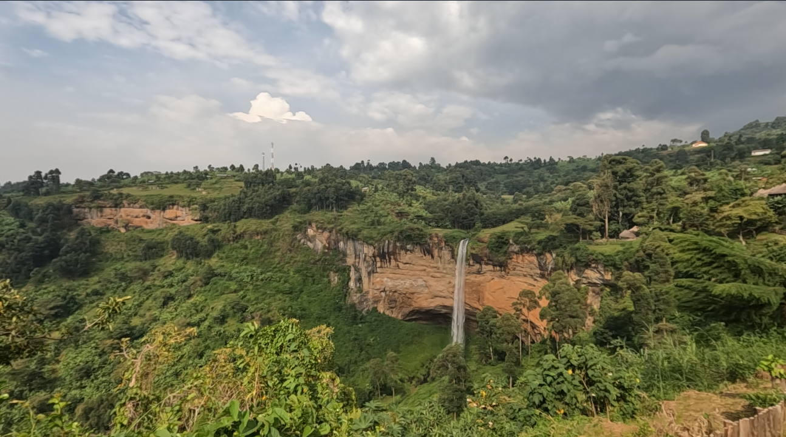
Case study
Inclusion of coffee farmers in high value markets in Kapchorwa, Uganda

Slide 28
Coffee buyers in Kapchorwa, Uganda
Located in all villages.
Open for longer periods
Typically, lower prices
Also includes traders who may aggregate or process locally
Commodity buyers
Smallholder coffee farmer
High value buyers
Often cluster at high altitude, closer to roads.
Compete on prices
Quality requirements higher, but barriers to entry relatively low.
Also includes cooperatives/farmer groups with direct links to downstream markets.

Slide 29
Participation in high value markets
Extensive margin (for households):
Whether anyone in the household sold any coffee to high value markets in the last harvest season.
Binary measure
210 observations
Intensive margin (for households):
The proportion of coffee sold to high value markets in the last harvest season.
Bounded continuous measure.
210 observations
Extensive margin (for individuals):
Whether the individual smallholder sells any of the coffee they market to high value markets. Individuals are either the household head or spouse.
Binary measure
411 observations

Slide 30
Circumstances (for household models)
Age (of household head) | Proportion of land owned vs rented
Education (of household head) | Assets (value for household)
Dependency ratio | Altitude of household
Social participation binary indicator (household head) | Distance to paved road from homestead
Coffee trees | Disagreements in declared responsibility for coffee marketing and income

Slide 31
Circumstances (for individual models)
Age (of individual) | Proportion of land owned vs rented (of household)
Education (of individual) | Assets (of individual)
Dependency ratio (of household) | Altitude of household
Social participation binary indicator (individual) | Distance to paved road from homestead
Coffee trees (of household) | Female (binary indicator)

Slide 32
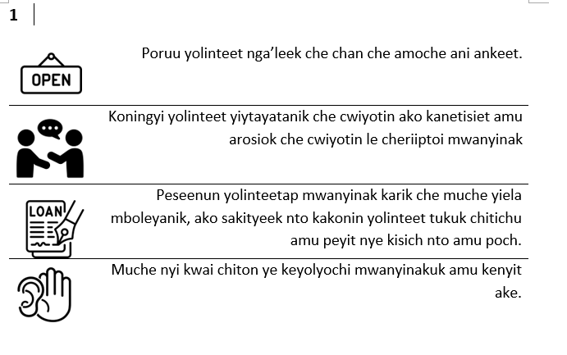
Preferences
Individuals were asked to 4 rank hypothetical buyer attributes from best to worst, over 6 questions.
This gave 36 pairwise best-worst scales over 8 attributes.
A mixed ranked ordered logit model was used to retrieve individual preference rankings across these attributes, while ensuring flexibility to preference heterogeneity across the sample.

Slide 33
Preferences
Price preferences | The estimated likelihood that the household head/individual ranks higher prices (100 shillings premium per kg of coffee cherries) as the most important attribute a hypothetical coffee buyer can offer.
Input preferences | The aggregate estimated likelihood that the household head/individual ranks either credit or input support as the most important attribute a hypothetical coffee buyer can offer.
Ease marketing preferences | (Omitted for collinearity – captures remaining preferences such as payment methods, )
Average price differential between commodity buyers and high value markets. | Captures how attractive the high value markets are relative to commodity buyers (from a price perspective).

Slide 34
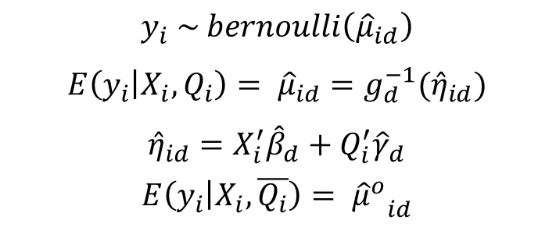
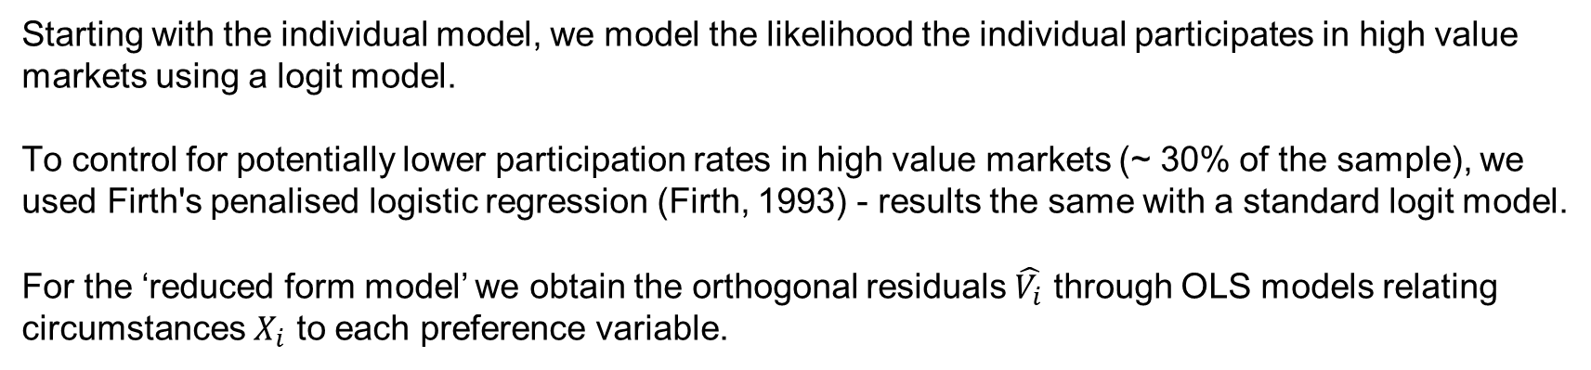
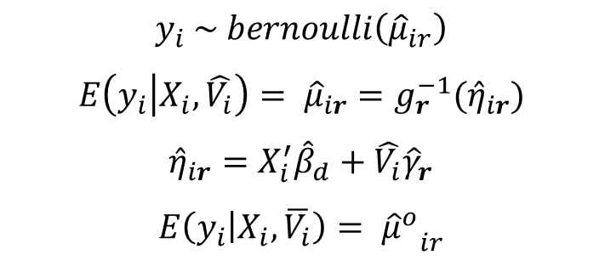
Empirical measurement of inclusion – binary extensive measures of participation for individuals
Starting with the individual model, we model the likelihood the individual participates in high value markets using a logit model.
To control for potentially lower participation rates in high value markets (~ 30% of the sample), we used Firth's penalised logistic regression (Firth, 1993) - results the same with a standard logit model.
For the ‘reduced form model’ we obtain the orthogonal residuals $\hat{V_{i}}$ through OLS models relating circumstances $X_{i}$ to each preference variable.
Direct model
Reduced form model
$$y_{i} \sim bernoulli\left({\hat{μ}}_{id}\right)$$
$$E\left(y_{i} | X_{i}, Q_{i}\right)= {\hat{μ}}_{id}=g_{d}^{−1}({\hat{η}}_{id})$$
$${\hat{η}}_{id}=X_{i}^{′}{\hat{β}}_{d}+Q_{i}^{′}{\hat{γ}}_{d}$$ $$E\left(y_{i} | X_{i}, \overline{Q_{i}}\right)= {{\hat{μ}}^{o}}_{id}$$
$$y_{i} \sim bernoulli\left({\hat{μ}}_{ir}\right)$$
$$E\left(y_{i} | X_{i}, \hat{V_{i}}\right)= {\hat{μ}}_{ir}=g_{r}^{−1}({\hat{η}}_{ir})$$
$${\hat{η}}_{ir}=X_{i}^{′}{\hat{β}}_{d}+\hat{V_{i}}{\hat{γ}}_{r}$$
$$E\left(y_{i} | X_{i}, \overline{V_{i}}\right)= {{\hat{μ}}^{o}}_{ir}$$

Slide 35
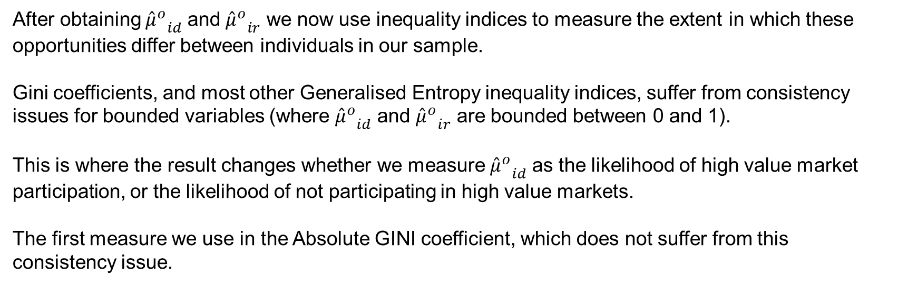
Empirical measurement of inclusion – binary extensive measures of participation
After obtaining ${{\hat{μ}}^{o}}_{id}$ and ${{\hat{μ}}^{o}}_{ir}$ we now use inequality indices to measure the extent in which these opportunities differ between individuals in our sample.
Gini coefficients, and most other Generalised Entropy inequality indices, suffer from consistency issues for bounded variables (where ${{\hat{μ}}^{o}}_{id}$ and ${{\hat{μ}}^{o}}_{ir}$ are bounded between 0 and 1).
This is where the result changes whether we measure ${{\hat{μ}}^{o}}_{id}$ as the likelihood of high value market participation, or the likelihood of not participating in high value markets.
The first measure we use in the Absolute GINI coefficient, which does not suffer from this consistency issue.

Slide 36
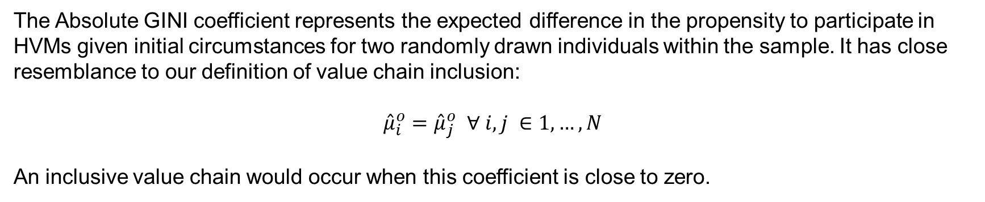

Empirical measurement of inclusion – binary extensive measures of participation
The Absolute GINI coefficient:
$$I_{Gini}^{o}=\frac{1}{2n^{2}}\sum_{i=1}^{I}{\sum_{j=1}^{J}{|{\hat{μ}}_{i}^{o} −{\hat{μ}}_{j}^{o}| }}$$
The Absolute GINI coefficient represents the expected difference in the propensity to participate in HVMs given initial circumstances for two randomly drawn individuals within the sample. It has close resemblance to our definition of value chain inclusion:
${\hat{μ}}_{i}^{o}={\hat{μ}}_{j}^{o}$ $∀ i,j ∈1,…,N$
An inclusive value chain would occur when this coefficient is close to zero.

Slide 37
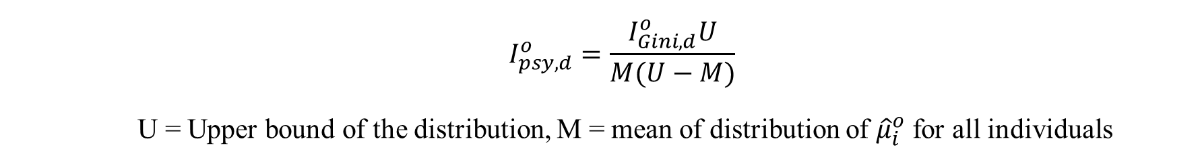
Empirical measurement of inclusion – binary extensive measures of participation
The Absolute Gini coefficient however suffers from boundary issues, where the index mechanically approaches zero when observations are clustered near the distribution boundaries (for example, if many observations have very low or very high likelihood of participation due to circumstances).
Permanyer, Seth, and Yalonetzky (2022) propose a modification which normalise typical inequality indices by the maximum value the inequality index could be given the mean of the distribution in question.
We use this approach by scaling the absolute Gini coefficient and is a more reliable measure when comparing outcomes across time and context.
$$I_{psy,d}^{o}=\frac{I_{Gini,d}^{o}U}{M(U−M)}$$
U = Upper bound of the distribution, M = mean of distribution of ${\hat{μ}}_{i}^{o}$ for all individuals

Slide 38
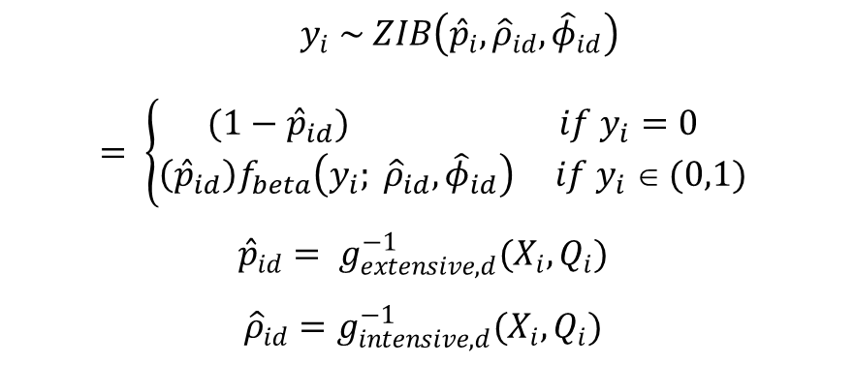
Empirical measurement of inclusion – household model
For households, we have two measures of participation – extensive participation (do they sell to high value markets or not) and intensive participation (proportion of coffee marketed to high value markets by the household.)
We can model inclusion for both dimensions through a a zero inflated beta regression model (Ospina & Ferrari, 2012), which assumes participation is distributed by a mixed distribution function represented by:
A beta distribution for positive continuous values and
A degenerate distribution function for zero values
Direct model
$$y_{i} \sim ZIB\left({\hat{p}}_{i}, {\hat{ρ}}_{id}, {\hat{φ}}_{id}\right)$$
$$= \left\{\begin{aligned}(1−{\hat{p}}_{id}) if y_{i}=0 \\ \left({\hat{p}}_{id}\right)f_{beta}\left(y_{i}; {\hat{ρ}}_{id}, {\hat{φ}}_{id}\right) if y_{i} ∈ (0,1)\end{aligned}\right.$$
$${\hat{p}}_{id}= g_{extensive, d}^{−1}(X_{i}, Q_{i})$$
$${\hat{ρ}}_{id}=g_{intensive,d}^{−1}(X_{i}, Q_{i})$$
(Equivalent also run for the reduced form model)

Slide 39
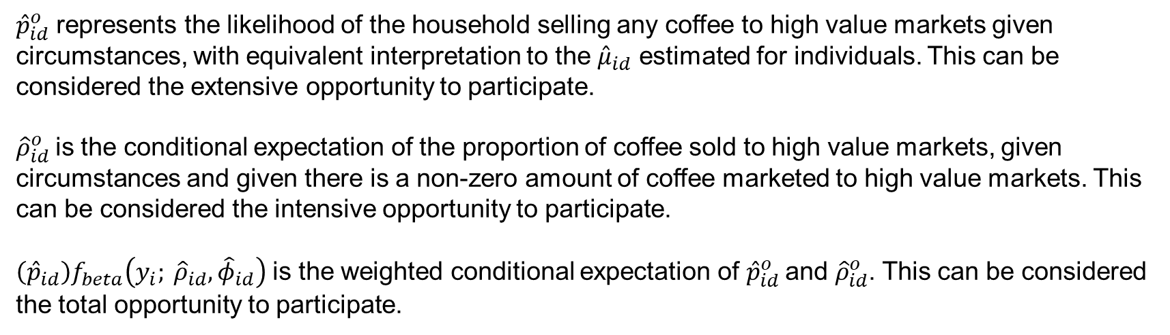
Empirical measurement of inclusion – household model
$${\hat{p}}_{id}^{o}= g_{extensive, d}^{−1}(X_{i}, \overline{Q_{i}})$$
$${\hat{ρ}}_{id}^{o}=g_{intensive,d}^{−1}(X_{i}, \overline{Q_{i}})$$
${\hat{p}}_{id}^{o}$ represents the likelihood of the household selling any coffee to high value markets given circumstances, with equivalent interpretation to the ${\hat{μ}}_{id}$ estimated for individuals. This can be considered the extensive opportunity to participate.
${\hat{ρ}}_{id}^{o}$is the conditional expectation of the proportion of coffee sold to high value markets, given circumstances and given there is a non-zero amount of coffee marketed to high value markets. This can be considered the intensive opportunity to participate.
$\left({\hat{p}}_{id}\right)f_{beta}\left(y_{i}; {\hat{ρ}}_{id}, {\hat{φ}}_{id}\right)$ is the weighted conditional expectation of ${\hat{p}}_{id}^{o}$and ${\hat{ρ}}_{id}^{o}$. This can be considered the total opportunity to participate.

Slide 40
Results

Slide 41
Selected coefficient results from the ‘Direct’ models
 | Extensive individual model | Extensive household model | Intensive household model
Intercept | -11.19*** (2.68) | 7.15** (2.93) | 2.27 (2.35)
Female respondent | 1.05** (0.38)
Age of head | 0.03** (0.01) | 0.02 (0.02) | -0.02* (0.01)
Education | 0.09* (0.04) | 0.07 (0.06) | 0.03 (0.04)
Dependency ratio | 0.06 (0.07) | 0.1 (0.1) | -0.18** (0.07)
Altitude | 3.11** (1.31) | 2.79* (1.53) | -1.38 (1.33)
Distance paved road | -0.57*** (0.16) | -0.65*** (0.17) | -0.11 (0.14)
Decision making disagreements | -1.13*** (0.34) | -0.98** (0.41) | -0.53 (0.32)
Price preferences | -0.06 (0.41) | 0.4 (0.55) | -0.38 (0.38)
Input preferences | 0.46 (0.56) | -0.69 (0.6) | 2.17*** (0.45)
Relative prices | 0.91*** (0.15) | 2.96** (1.16) | 4.00*** (0.73)
Spatial factors are clearly an important factor for value chain participation.
Spatial clustering of high value buyers means that households located at lower altitudes (where coffee quality diminishes) and further from the main roads are less likely to participate.

Slide 42
Selected coefficient results from the ‘Direct’ models
 | Extensive individual model | Extensive household model | Intensive household model
Intercept | -11.19*** (2.68) | 7.15** (2.93) | 2.27 (2.35)
Female respondent | 1.05** (0.38)
Age of head | 0.03** (0.01) | 0.02 (0.02) | -0.02* (0.01)
Education | 0.09* (0.04) | 0.07 (0.06) | 0.03 (0.04)
Dependency ratio | 0.06 (0.07) | 0.1 (0.1) | -0.18** (0.07)
Altitude | 3.11** (1.31) | 2.79* (1.53) | -1.38 (1.33)
Distance paved road | -0.57*** (0.16) | -0.65*** (0.17) | -0.11 (0.14)
Decision making disagreements | -1.13*** (0.34) | -0.98** (0.41) | -0.53 (0.32)
Price preferences | -0.06 (0.41) | 0.4 (0.55) | -0.38 (0.38)
Input preferences | 0.46 (0.56) | -0.69 (0.6) | 2.17*** (0.45)
Relative prices | 0.91*** (0.15) | 2.96** (1.16) | 4.00*** (0.73)
Women are more likely to participate in high value markets
Likely driven from several women’s only cooperatives which fill important niches for market access and other social services (e.g. ROSCAs).
Results are hidden from household models, emphasising the importance of defining the primary sampling unit correctly.

Slide 43
Selected coefficient results from the ‘Direct’ models
 | Extensive individual model | Extensive household model | Intensive household model
Intercept | -11.19*** (2.68) | 7.15** (2.93) | 2.27 (2.35)
Female respondent | 1.05** (0.38)
Age of head | 0.03** (0.01) | 0.02 (0.02) | -0.02* (0.01)
Education | 0.09* (0.04) | 0.07 (0.06) | 0.03 (0.04)
Dependency ratio | 0.06 (0.07) | 0.1 (0.1) | -0.18** (0.07)
Altitude | 3.11** (1.31) | 2.79* (1.53) | -1.38 (1.33)
Distance paved road | -0.57*** (0.16) | -0.65*** (0.17) | -0.11 (0.14)
Decision making disagreements | -1.13*** (0.34) | -0.98** (0.41) | -0.53 (0.32)
Price preferences | -0.06 (0.41) | 0.4 (0.55) | -0.38 (0.38)
Input preferences | 0.46 (0.56) | -0.69 (0.6) | 2.17*** (0.45)
Relative prices | 0.91*** (0.15) | 2.96** (1.16) | 4.00*** (0.73)
Households with significant decision-making disagreements over coffee income and marketing are less likely to participate in high value markets.
We interpret this as individuals acting opportunistically to divert resources from kinship claims or to hide income. This is done through traders and commodity buyers, who are always open and have low barriers to entry.

Slide 44
Selected coefficient results from the ‘Direct’ models
 | Extensive individual model | Extensive household model | Intensive household model
Intercept | -11.19*** (2.68) | 7.15** (2.93) | 2.27 (2.35)
Female respondent | 1.05** (0.38)
Age of head | 0.03** (0.01) | 0.02 (0.02) | -0.02* (0.01)
Education | 0.09* (0.04) | 0.07 (0.06) | 0.03 (0.04)
Dependency ratio | 0.06 (0.07) | 0.1 (0.1) | -0.18** (0.07)
Altitude | 3.11** (1.31) | 2.79* (1.53) | -1.38 (1.33)
Distance paved road | -0.57*** (0.16) | -0.65*** (0.17) | -0.11 (0.14)
Decision making disagreements | -1.13*** (0.34) | -0.98** (0.41) | -0.53 (0.32)
Price preferences | -0.06 (0.41) | 0.4 (0.55) | -0.38 (0.38)
Input preferences | 0.46 (0.56) | -0.69 (0.6) | 2.17*** (0.45)
Relative prices | 0.91*** (0.15) | 2.96** (1.16) | 4.00*** (0.73)
Higher relative prices in high value markets relative to commodity markets acts as a pull factor for higher rates of participation
Those with higher preferences for inputs more likely to sell a higher proportion of their coffee to high value markets
Possibly reflecting the type of buyers/farmer groups these households engage with, where higher volumes of coffee required to receive input support.

Slide 45
Summary of reduced form model results
In the first stage models:
Women are more likely to prefer buyers with higher prices relative to men.
One reason for this could be different underlying preferences in what coffee income should be used for within the household, with women prioritising higher income from coffee, at the cost of maybe flexibility and input support.
Prices are higher in ar
In the second stage models, the results largely align with the direct models across the circumstance variables, with the magnitude of these coefficients changing (as now these coefficients are capturing both the direct effects of these circumstances, and the indirect effects of preferences associated with these circumstances.)

Slide 46
Inequality in opportunity results
 | Individual extensive opportunity to participate |  | Household extensive opportunity to participate |  | Household intensive opportunity to participate |  | Household total opportunity to participate
 | PSY Normalised Gini | Absolute Gini | PSY Normalised Gini | Absolute Gini | PSY Normalised Gini | Absolute Gini | PSY Normalised Gini | Absolute Gini
‘Direct’ model
Mean estimate | 0.601 | 0.063 | 0.618 | 0.096 | 0.521 | 0.078 | 0.634 | 0.022
Lower bound for bootstrapped estimates | 0.595 | 0.063 | 0.612 | 0.095 | 0.510 | 0.075 | 0.628 | 0.022
Upper bound for bootstrapped estimates | 0.607 | 0.064 | 0.624 | 0.097 | 0.531 | 0.080 | 0.641 | 0.023
‘Reduced-form’ model
Mean estimate | 0.734 | 0.100 | 0.630 | 0.098 | 0.537 | 0.082 | 0.663 | 0.026
Lower bound for bootstrapped estimates | 0.729 | 0.099 | 0.624 | 0.096 | 0.526 | 0.080 | 0.656 | 0.026
Upper bound for bootstrapped estimates | 0.738 | 0.101 | 0.636 | 0.099 | 0.548 | 0.085 | 0.669 | 0.027
Across the models, there is a moderate amount of inequality in participation opportunities, and do not suggest the coffee HVMs are perfectly inclusive in opportunity.
The bootstrapped confidence intervals suggest these high value markets are far from being perfectly inclusive.

Slide 47
 | Individual extensive opportunity to participate |  | Household extensive opportunity to participate |  | Household intensive opportunity to participate |  | Household total opportunity to participate
 | PSY Normalised Gini | Absolute Gini | PSY Normalised Gini | Absolute Gini | PSY Normalised Gini | Absolute Gini | PSY Normalised Gini | Absolute Gini
‘Direct’ model
Mean estimate | 0.601 | 0.063 | 0.618 | 0.096 | 0.521 | 0.078 | 0.634 | 0.022
Lower bound for bootstrapped estimates | 0.595 | 0.063 | 0.612 | 0.095 | 0.510 | 0.075 | 0.628 | 0.022
Upper bound for bootstrapped estimates | 0.607 | 0.064 | 0.624 | 0.097 | 0.531 | 0.080 | 0.641 | 0.023
‘Reduced-form’ model
Mean estimate | 0.734 | 0.100 | 0.630 | 0.098 | 0.537 | 0.082 | 0.663 | 0.026
Lower bound for bootstrapped estimates | 0.729 | 0.099 | 0.624 | 0.096 | 0.526 | 0.080 | 0.656 | 0.026
Upper bound for bootstrapped estimates | 0.738 | 0.101 | 0.636 | 0.099 | 0.548 | 0.085 | 0.669 | 0.027
For two randomly drawn individuals, the expected difference in the propensity to participate in high value markets given initial circumstances is about 6%. This is a lower bound estimate due to boundary issues with the Absolute Gini, and the PSY measure suggests a much higher result.
The inequality in opportunity grows for all reduced form models.
This is because spatial factors such as distances to paved roads and altitude not only determine which individuals are able to participate (based on location), but clustering of buyers in these preferred locations pushes up prices from buyers (which increases the pull factors for smallholders to participate in high value markets).

Slide 48
 | Individual extensive opportunity to participate |  | Household extensive opportunity to participate |  | Household intensive opportunity to participate |  | Household total opportunity to participate
 | PSY Normalised Gini | Absolute Gini | PSY Normalised Gini | Absolute Gini | PSY Normalised Gini | Absolute Gini | PSY Normalised Gini | Absolute Gini
‘Direct’ model
Mean estimate | 0.601 | 0.063 | 0.618 | 0.096 | 0.521 | 0.078 | 0.634 | 0.022
Lower bound for bootstrapped estimates | 0.595 | 0.063 | 0.612 | 0.095 | 0.510 | 0.075 | 0.628 | 0.022
Upper bound for bootstrapped estimates | 0.607 | 0.064 | 0.624 | 0.097 | 0.531 | 0.080 | 0.641 | 0.023
‘Reduced-form’ model
Mean estimate | 0.734 | 0.100 | 0.630 | 0.098 | 0.537 | 0.082 | 0.663 | 0.026
Lower bound for bootstrapped estimates | 0.729 | 0.099 | 0.624 | 0.096 | 0.526 | 0.080 | 0.656 | 0.026
Upper bound for bootstrapped estimates | 0.738 | 0.101 | 0.636 | 0.099 | 0.548 | 0.085 | 0.669 | 0.027
The intensive household model is slightly more inclusive than the extensive model
Smallholders with labour constraints often harvest all cherries at once, meaning only a small fraction of total harvest that can be sorted out as ripe cherries suitable for high value markets.

Slide 49
 | Individual extensive opportunity to participate |  | Household extensive opportunity to participate |  | Household intensive opportunity to participate |  | Household total opportunity to participate
 | PSY Normalised Gini | Absolute Gini | PSY Normalised Gini | Absolute Gini | PSY Normalised Gini | Absolute Gini | PSY Normalised Gini | Absolute Gini
‘Direct’ model
Mean estimate | 0.601 | 0.063 | 0.618 | 0.096 | 0.521 | 0.078 | 0.634 | 0.022
Mean estimate when setting all insignificant coefficients to zero | 0.600 | 0.040 | 0.432 | 0.062 | 0.466 | 0.070 | 0.459 | 0.035
‘Reduced-form’ model
Mean estimate | 0.734 | 0.100 | 0.630 | 0.098 | 0.537 | 0.082 | 0.663 | 0.026
Mean estimate when setting all insignificant coefficients to zero | 0.740 | 0.071 | 0.448 | 0.063 | 0.483 | 0.071 | 0.513 | 0.033
We also estimate the opportunities to participate in high value markets by setting circumstances that are statistically insignificant to zero.
These inequality indices may represent our lower confidence level of the inequality in HVM participation opportunities.
Even at this lower bound, inequality in opportunities is relatively moderate given the significant role in which spatial factors appear to influence extensive and intensive participation.

Slide 50
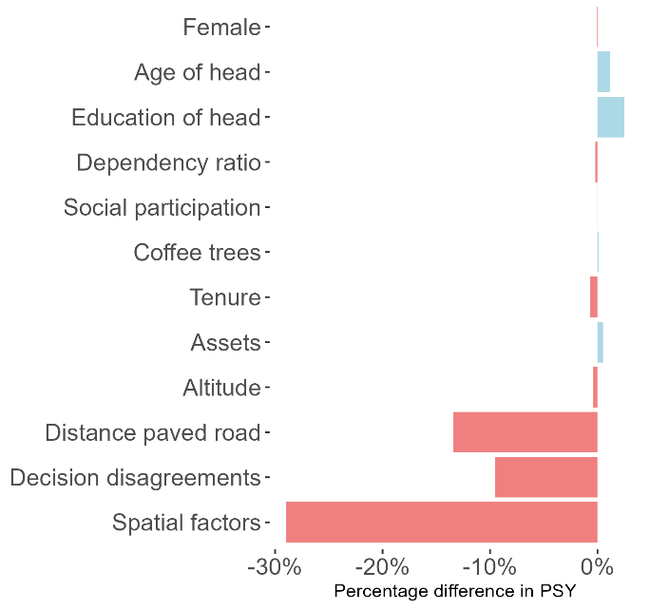
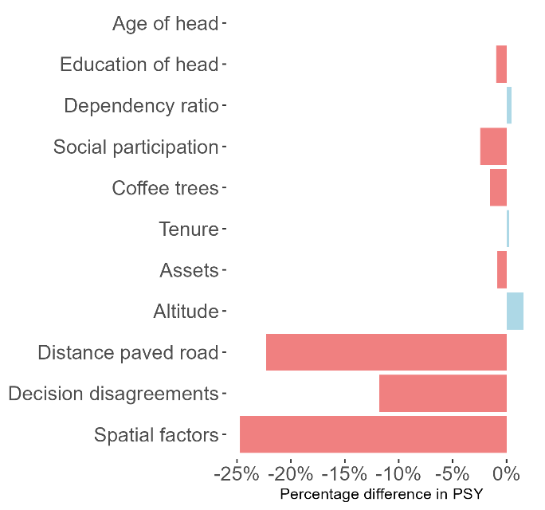
Marginal contributions of circumstances to inclusion results
Changes in normalised Gini in opportunity when equalising variation of individual circumstances (relative to direct model mean estimate) – Individual extensive opportunity to participate.
Changes in normalised Gini in opportunity when equalising variation of individual circumstances (relative to direct model mean estimate) – household total opportunity participate

Slide 51
Marginal contributions of circumstances to inclusion results
Equalising spatial factors, such as altitude and distances to paved roads, reduces inequality by significant margins across all models. Equalising spatial factors reduces the normalised Gini coefficient (PSY) by nearly 30% for the extensive participation at an individual level, and 25% for the total inclusion measure at a household level.
Disagreements in coffee marketing decision making is the second most significant factor
Discrete marketing behaviour may enable certain individuals to have greater bargaining power over economic resources in the household (Hill et al., 2024), meaning it may be important for the HVM buyers to offer options for individuals to make discrete transactions while also ensuring they receive the higher prices that is offered by these HVMs.

Slide 52
Conclusions - Possible ways forward for Kapchorwa
Social policy to enable better cooperation of household decision making, such as through Joint Participatory decision-making interventions (up to 10-15% improvement in inclusion)
Promote travelling buying agents or collection points in villages where high value market access is currently limited (up to 25-30% improvement in inclusion)
High value markets enabling more flexible and discrete procurement options (up to 10-15% improvement in inclusion)
Supporting excluded farmers is costly, difficult to coordinate and is prone to public-good incentives.
The costs of engaging with excluded cohorts may outweigh the benefits,
And may be borne by existing participants.

Slide 53
Conclusions – for value chain assessment
These methods help us think about better market design for smallholders by better understanding why smallholders are excluded and to measure how inclusion outcomes change over time or due to intervention.
Impact evaluations are the gold standard for value chain assessments, but have narrowed our focus onto efficiency outcomes alone
We adapt simple methods that are designed to be complementary to current impact evaluation approaches.

